Slide 1
Change
Morgan powell

Slide 2
OVERVIEW OF PROJECT
Global warming
Climate change
Effects of it
Change versus tradition
impacts

Slide 3

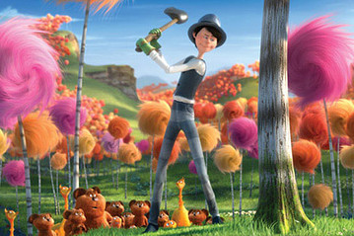
Dr suess the lorax
One of the main influences for my project is ”The Lorax” movie as it has a good use of contrast using specific colours as well as exploring the habitat with animals which will engage with the audience.

Slide 4
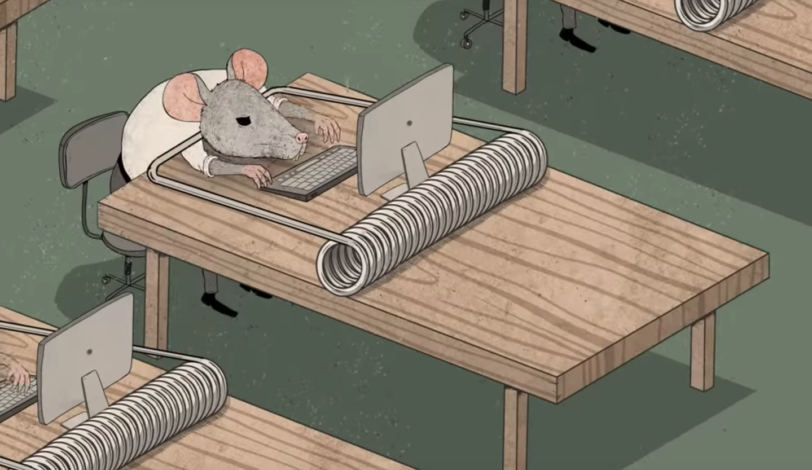
Steve Cutts
Steve Cutts is an illustrator who does a lot of animation shorts about climate change and the effects of pollution. He uses very smart imagery to show multiple different meanings withing his animations.

Slide 5
Audience
Explain who the project is for?
Any evidence for your statements (sales figures/popularity)
Why should they like this?
Where will it be seen?
Is it interactive?

Slide 6
Ideas and Theme of Project
What are the main ideas and themes ?
What would you like the audience to feel/experience?
Show a slide of the project here, and explain the STORY/NARRATIVE

Slide 7
Initial Design Sheets and Project Development
A few sheets showing how the ideas developed.
Design sheets for characters/environments/props/vehicles
Storyboards

Slide 8
CONCEPT ART AND FINALISED DESIGN SHEETS
Include storyboards and digital art.

Slide 9
Experimentation and Practical Skills
How you made the product.
What experimentation in materials/techniques/new skills did you use?
A few slides showing your experimentation.
Discuss the decision making you went through from the experimentation stage

Slide 10
Planning and Production
Showing the planning and production of final elements for your project.

Slide 11
THE FINAL PIECE
Show the final project, in whatever state it is currently, demo or test piece.
This will be useful for feedback.

Slide 12
Problems and Solutions
Consider the projects strengths and weakness-
What do you need to complete for the project to be successful?
What are the issues you may face- time/skills/equipment etc?

Slide 13
ANY QUESTIONS
Ask and answer any questions about your project.
A survey could be placed online or handed out to your audience
Try to obtain useful and constructive information that you can use to enhance your final project.

